Slide 1
Leading Attrition Factors
MSDS 6306: Doing Data Science
Case Study 02
I.A.WILDS

Slide 2
Understanding the data
ID Age Attrition
BusinessTravel DailyRate Department
DistanceFromHome Education EducationField
EnvironmentSatisfaction Gender HourlyRate
JobInvolvement JobLevel JobRole
JobSatisfaction MaritalStatus MonthlyIncome
MonthlyRate NumCompaniesWorked OverTime
PercentSalaryHike PerformanceRating RelationshipSatisfaction
StockOptionLevel TotalWorkingYears TrainingTimesLastYear
WorkLifeBalance YearsAtCompany YearsInCurrentRole
YearsSinceLastPromotion YearsWithCurrManager

Slide 3
Goals
Identify the factors that lead to attrition.
Isolate the 3 most impactful factors.
Discuss any job role specific trends
Predict missing Attrition inputs
Predict missing Monthly Income inputs

Slide 4
Discovery methods
Naïve Bayes
K-Nearest Neighbor
Simple Linear Regression
Random Forest

Slide 5
The Big 3
Overtime
Stock option level
Job role
These three appear to be the top factors that are leading to attrition. Of the members that chose to leave the company, 57% of them worked overtime. 70% of them had stock option levels at 0. Lastly, the predictor Job Role Sales Representative has the third most significant impact on attrition.

Slide 6
Analysis
Many statistical software packages include a very helpful analysis. They can calculate the increase in R-squared when each variable is added to a model that already contains all of the other variables.
how much does the R-squared value increase for each variable when it is added last.

Slide 7
NAÏVE BAYES PREDICTORS
EnvironmentSatisfaction
WorkLifeBalance
JobLevel
JobSatisfaction
RelationshipSatisfaction
OverTime
PerformanceRating
JobRole
YearsInCurrentRole
StockOptionLevel
JobInvolvement
TotalWorkingYears
YearsSinceLastPromotion

Slide 8
NAÏVE BAYES TEST CASE RESULTS
prednb No Yes
No 201 23
Yes 12 25
Accuracy : 0.8659
Sensitivity : 0.9437
Specificity : 0.5208

Slide 9
K NEAREST NEIGHBOR PREDICTORS
YearsInCurrentRole
MaritalStatus
StockOptionLevel
YearsWithCurrManager
OverTime
YearsAtCompany

Slide 10
K NEAREST NEIGHBOR TEST CASE RESULTS
tunedcase
1 2
1 210 3
2 38 10
Accuracy : 0.8429
Sensitivity : 0.8468
Specificity : 0.7692

Slide 11
SIMPLE LINEAR REGRESSION PREDICTORS
OverTime
JobRole
StockOptionLevel
JobInvolvement
YearsSinceLastPromotion
WorkLifeBalance
JobSatisfaction
EducationField
BusinessTravel
NumCompaniesWorked
MaritalStatus
TrainingTimesLastYear
YearsAtCompany

Slide 12
SIMPLE LINEAR REGRESSION TEST RESULTS
Mean Square Prediction Error 0.1291826
The model predicts with 95% confidence that the intercept is between 1.05 and 1.71
Adjusted R-squared: 0.2396

Slide 13
RANDOM FOREST TEST CASE PREDICTORS
OverTime
JobRole
StockOptionLevel
JobInvolvement
YearsSinceLastPromotion
WorkLifeBalance
JobSatisfaction
EducationField
BusinessTravel
NumCompaniesWorked
MaritalStatus
TrainingTimesLastYear
YearsAtCompany

Slide 14
RANDOM FOREST TEST RESULTS
Accuracy 0.8638598
Kappa 0.2021419
Reference
Prediction No Yes
No 212 43
Yes 1 5
Accuracy : 0.8314
Sensitivity : 0.9953
Specificity : 0.1042

Slide 15
RANDOM FOREST IMPORTANCE
OverTimeYes | 100.00000
StockOptionLevel1 | 51.01806
JobRoleSales Representative | 49.85533
MaritalStatusSingle | 37.96671
StockOptionLevel2 | 36.94064
YearsAtCompany1 | 31.87644
JobRoleManufacturing Director | 30.26627
YearsSinceLastPromotion7 | 26.86952
NumCompaniesWorked5 | 24.75160
NumCompaniesWorked6 | 24.69935

Slide 16
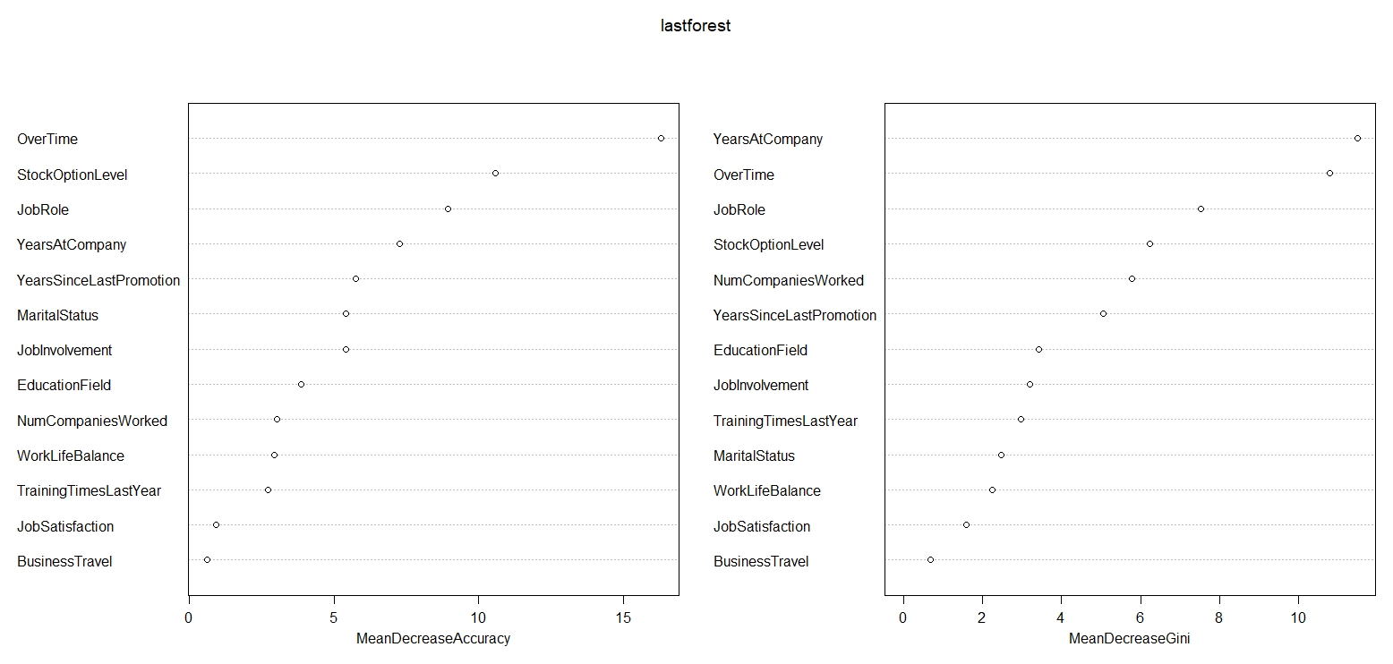
IMPORTANCE

Slide 17
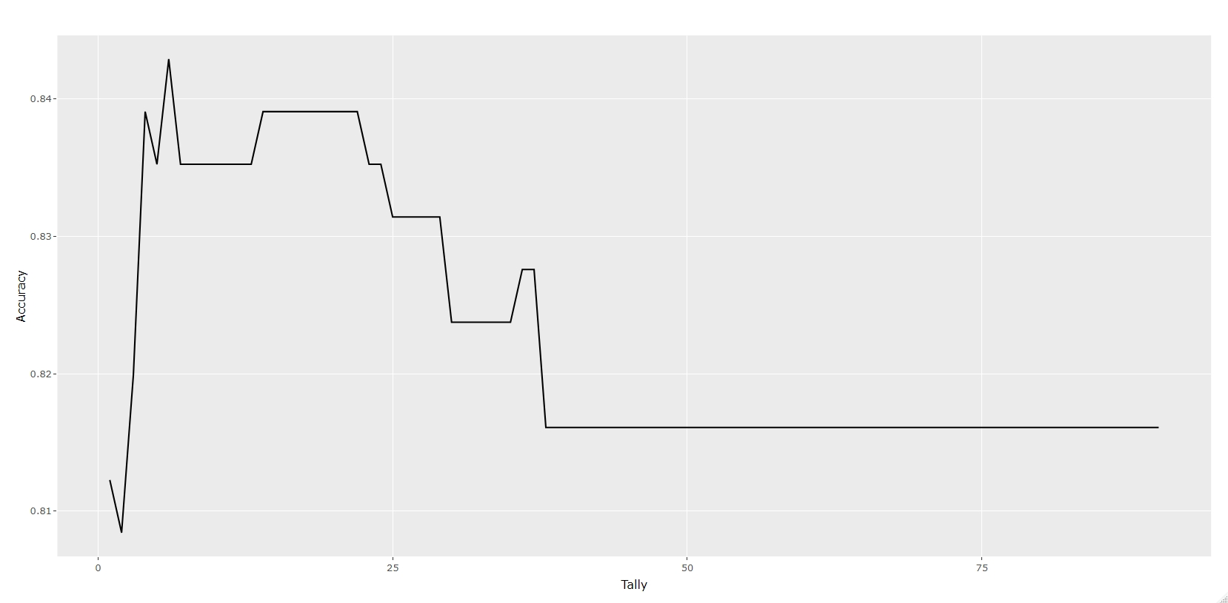
Best K VALUE

Slide 18
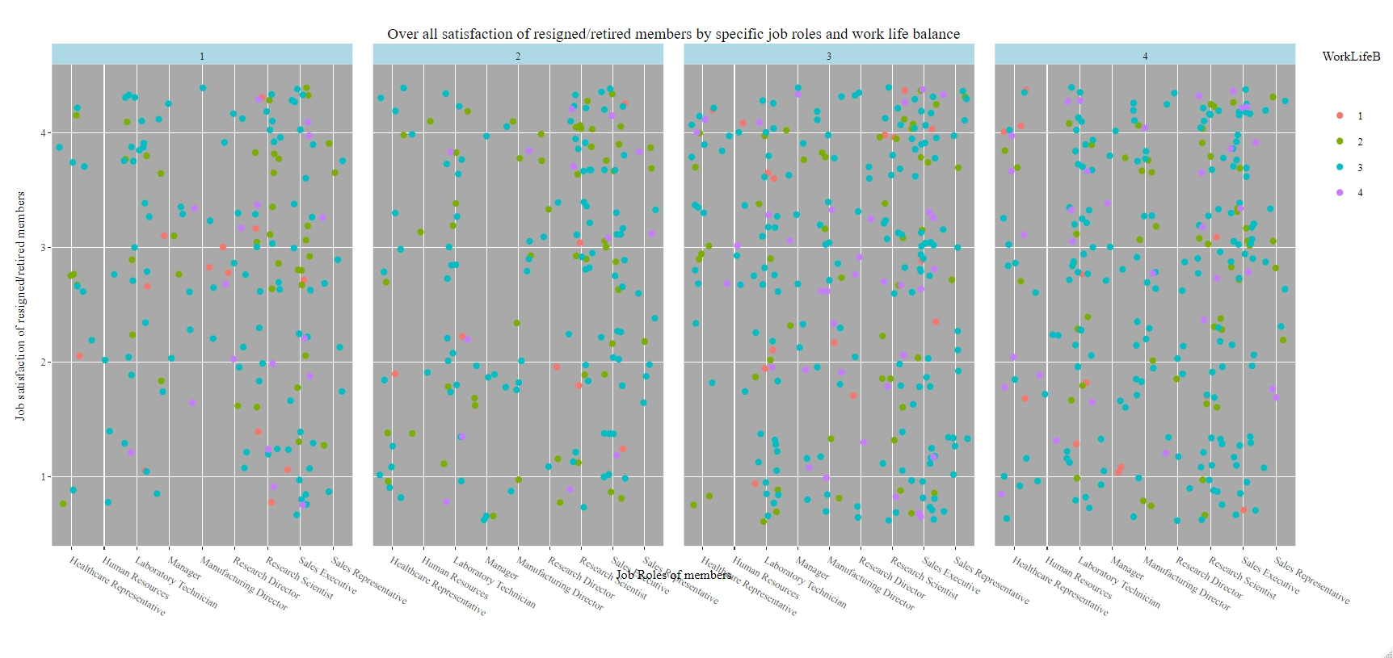
OVERALL JOB ROLES SATISFACTION

Slide 19
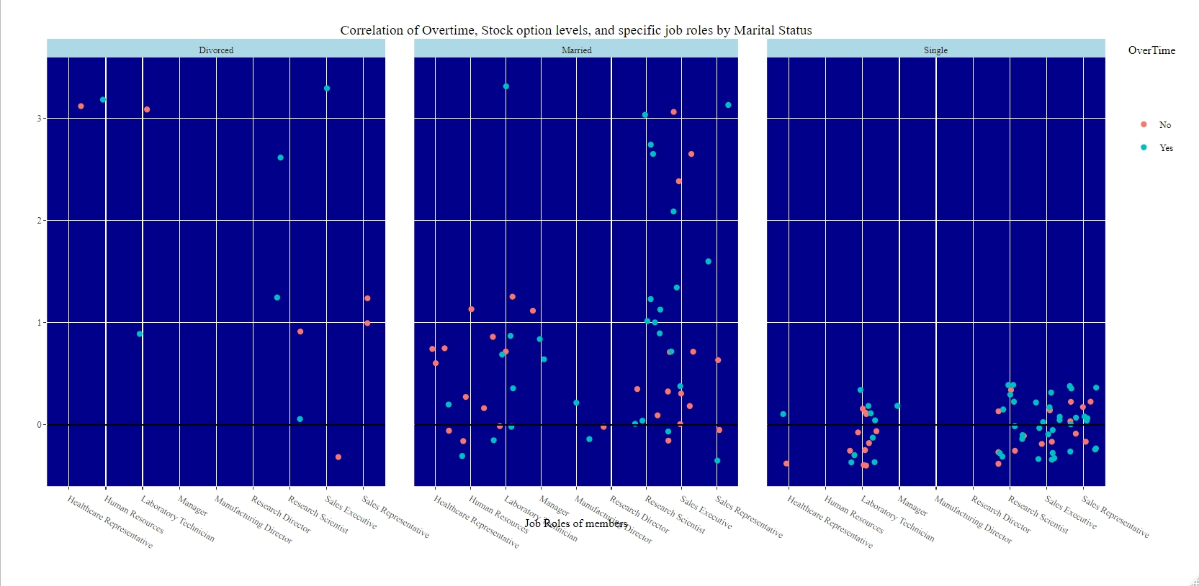
LEADING THREE FACTORS

Slide 20
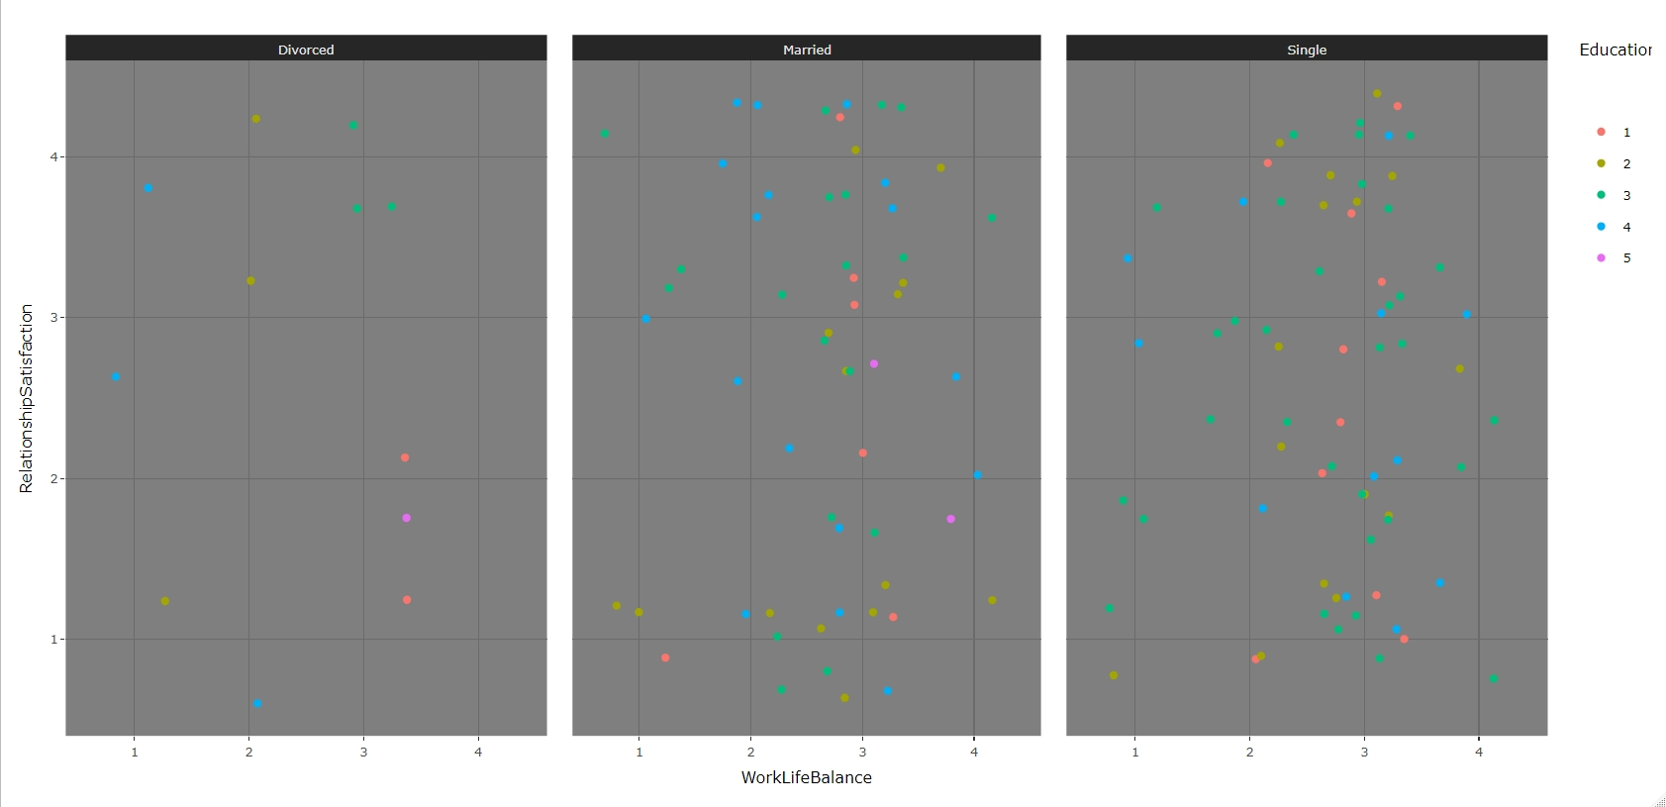
PERSONAL FACTORS

Slide 21
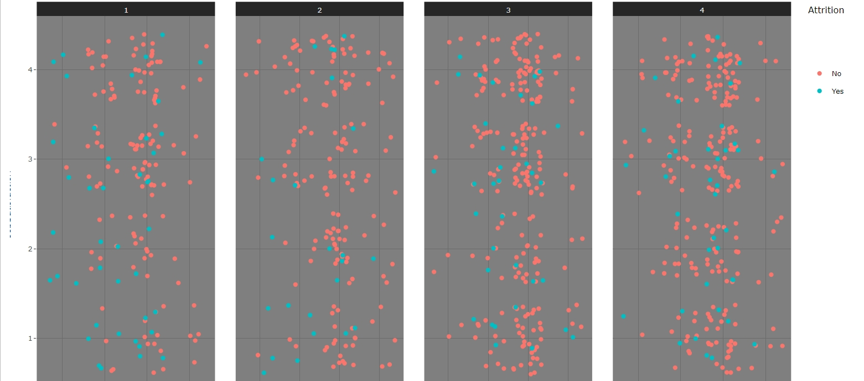
GENERAL EMPLOYEE SATISFACTION

Slide 22
Predicting missing Attrition values
Naïve Bayes Model was used to predict the missing values.
A new dataframe was created to hold the new predicted values and to test against.
There were 261 values in the test data and 300 values in the data set with missing Attrition.
An additional 39 values were selected at random from the test data and placed back in the population to reach 300.

Slide 23
Naive Bayes Competition Set Results
predattrit No Yes
No 221 51
Yes 22 6
Accuracy : 0.7567
Sensitivity : 0.9095
Specificity : 0.1053

Slide 24
kNN Competition Set Results
tunedCOMP
1 2
1 271 1
2 22 6
Accuracy : 0.9233
Sensitivity : 0.9249
Specificity : 0.8571

Slide 25
Simple Linear Regression Competition Set Results
0.09124809

Slide 26
Predicting missing Monthly Income values
Naïve Bayes model was used to predict the missing values.
A new dataframe was created that held the new information.

Slide 27
Simple Linear Regression Predictors
YearsAtCompany
YearsInCurrentRole
YearsSinceLastPromotion
EnvironmentSatisfaction
OverTime
JobRole
NumCompaniesWorked
JobLevel

Slide 28
Simple Linear Regression
ROOT MEAN SQUARED ERROR
2700.00

Slide 29
Resources
https://youtu.be/01KKtmh-oX0
https://github.com/wildzealot/CaseStudy2DDS

